Slide 1
Tree Mover’s Distance: Bridging Graph Metrics and Stability of Graph Neural Networks
Ching-Yao Chuang MIT CSAIL cychuang@mit.edu
Stefanie Jegelka MIT CSAIL stefje@mit.edu

Slide 2
背景
1.Graph Similarity: non-Euclidean data such as graphs
2.GNN、graph kernel、Distance Metrics
3.GNN will fail to distinguish certain graphs:
most graph kernels use a naive aggregation of the final set of substructures, usually a sum or average, thereby potentially discarding valuable information about the distribution of individual components.
Generalization 较差
without specifying the behavior for gradual shifts in distributions
For message passing GNNs, Yehudai et al. [57] study perturbations of graph size, and demonstrate the importance of local computation
trees.

Slide 3
graph kernel：Most graph kernels lie in the framework of R -convolutional [ 21 ], and measure similarity by comparing substructures. Many R -convolutional kernels have limited expressive power and sometimes struggle to handle continuously attributed graphs [ 46 ].
The main idea is to decompose graph G into substructures and to define a kernel value k(G,G 0 ) as a combination of substructure similarities. A pioneer kernel on graphs was presented by [ 19 ], where node and edge attributes are exploited for label sequence generation using a random walk scheme.
Successively, a more efficient approach based on shortest paths [ 5 ] was proposed, which computes each kernel value k(G,G 0 ) as a sum of the similarities between each shortest path in G and each shortest path in G 0 .
Despite the practical success of R-Convolution kernels, they often rely on aggregation strategies that ignore valuable information, such as the distribution of the substructures. An example is the Weisfeiler–Lehman (WL) subtree kernel or one of its variants [ 33 , 37 , 38 ], which generates graph-level features by summing the contribution of the node representations.

Slide 4
Moreover, several recent works highlight the importance of local structures – computation trees resulting from unrolling the message passing process – for the approximation power of GNNs and their inability to distinguish certain pairs of graphs [ 2 , 20 , 34 , 55 ].
（Wasserstein Weisfeiler-Leman）WWL、TMD： desire a metric that reflects the structure of computation trees and the distribution of node attributes within trees.
WWL： computes an optimal transport distance between node embeddings of two graphs. The embeddings are computed via message passing, which aligns with the computation of GNNs, but loses structural information within trees.
TMD：a simple SVM based on TMD performs competitively with standard GNNs and graph kernels on graph classification benchmarks

Slide 5
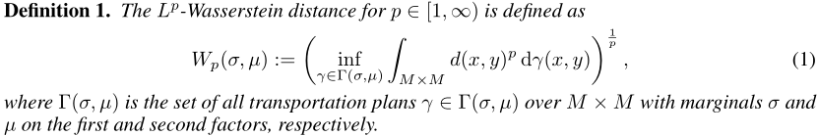

Wasserstein Weisfeiler-Leman
Wasserstein distance
Wasserstein distance is linked to the optimal transport problem：transport all the probability mass from distribution ? to match distribution µ
Here, M is the distance matrix containing the distances d(x,x 0 ) between each element x of X and x 0 of X 0 , P 2 ? is a transport matrix (or joint probability), and h·,·i is the Frobenius dot product. The transport matrix P contains the fractions that indicate how to transport the values from X to X 0 with the minimal total transport effort.

Slide 6
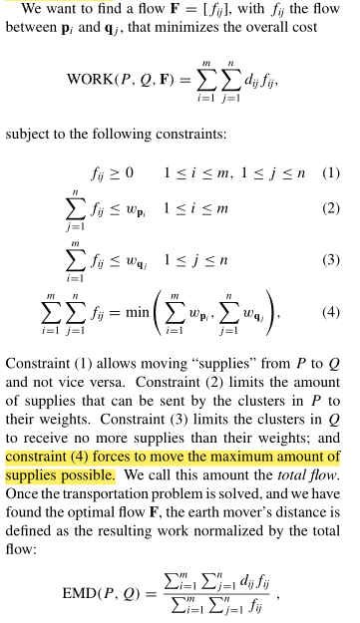
Wasserstein Weisfeiler-Leman
Transportation problem(Hitchcock, 1941)
find a least-expensive flow of weights from Graph G to the G’ that satisfies the G’s weight:
Let P ={(p 1 ,w p 1 ),...,(p m ,w p m )} be the first signature with m clusters, where p i is the cluster representative and w p i is the weight of The cluster; Q = {(q 1 ,w q 1 ),...,(q n ,w q n )}the second signature with n clusters; and D = [d ij ] the ground distance matrix where d ij is the ground distance between clusters p i and q j .
单纯形法和Other efficient methods to solve the transportation problem include interior-point algorithms (Karmarkar, 1984) which have polynomial time complexity, and by formalizing the transportation as the uncapacitated minimum cost network flow problem (Ahuja et al.,1993), it can be solved in our case of bipartite graph in O(n^3logn),
Notes:
在WWL里面，w_p_i=1

Slide 7
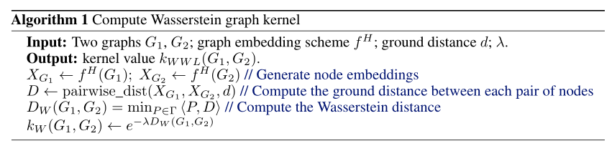
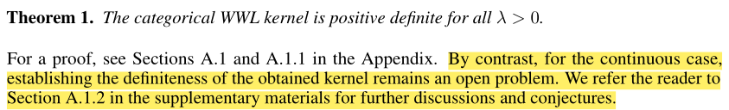
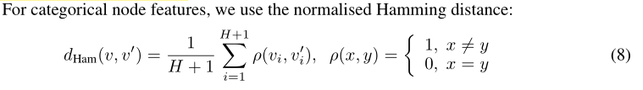


Wasserstein Weisfeiler-Leman

Slide 8
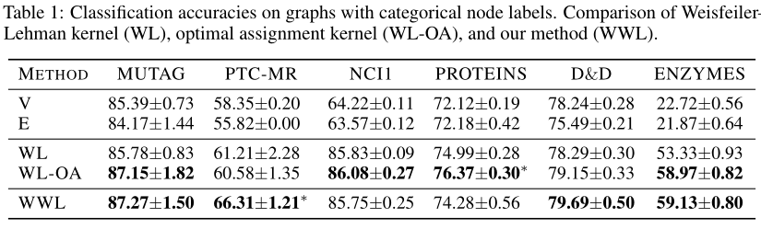
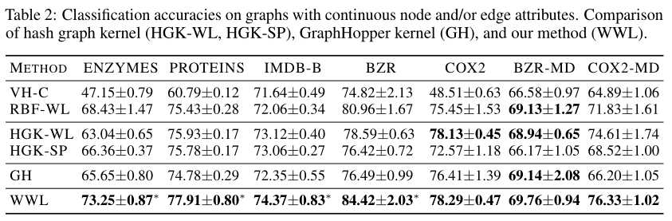
Wasserstein Weisfeiler-Leman
WWL (1) is competitive with the best graph kernel for categorically labelled data, and (2) outperforms all the state-of-the-art graph kernels for attributed graphs.

Slide 9
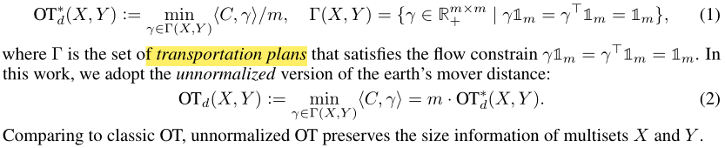
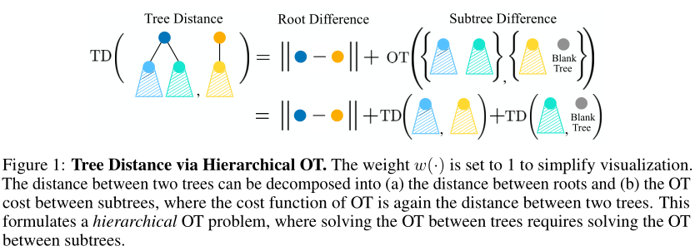
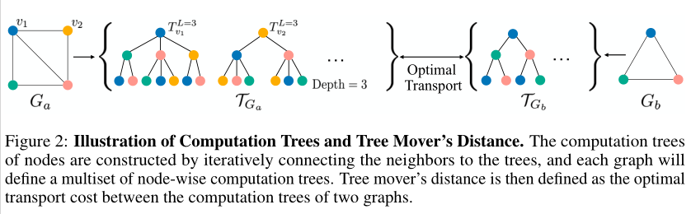
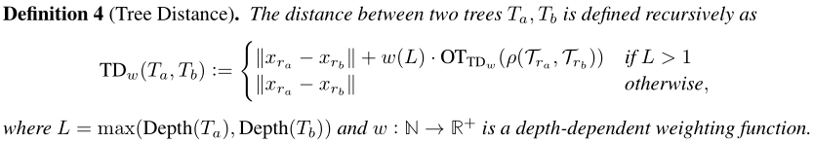

Tree Mover’s Distance
Let X = {x i } m i=1 and Y = {y i } m j=1 be two multisets of m elements each. Let C ∈ R m×m be the transportation cost for each pair: C ij = d(x i ,y j ) where d is the distance between x i and y j . The earth mover’s distance solves the following OT problem:
Computation Trees
If depth- L computation trees are the same for two nodes, they share similar neighborhoods up to L steps away.
Distance between Trees via Hierarchical OT
Figure 1 gives an illustration of computing tree distances. The tree distance TD w (T a ,T b ) aims to optimally align two trees T a and T b by recursively comparing their roots and subtrees.
a hierarchical optimal transport problem: the distance of two trees is defined via the distances of subtrees, where the importance of each level is determined by the weight w(·) . Increasingw(·) upweights the effect of nodes in the subtrees
TMD remains highly expressive on graphs with high dimensional continuous attributes, where most R –convolutional graph kernels struggle [ 46 ].
Definition 5 ( Tree Mover’s Distance ) . Given two graphs G a ,G b and w,L ≥ 0 , the tree mover’s distance between G a and G b is defined as

Slide 10
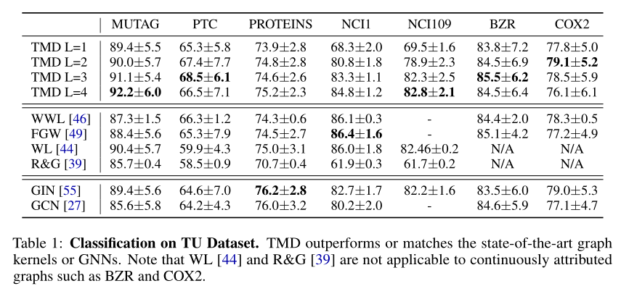
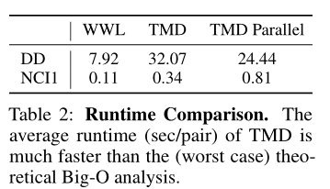
Tree Mover’s Distance
TMD outperforms or matches the performances of state-of-the-art GNNs, graph kernels, and metrics, implying that it captures meaningful structural properties of graphs.
Ramon & Gärtner kernel [ 39 ], WL subtree kernel [ 44 ]; two
widely-adopted GNNs: graph isomorphism network (GIN) [ 55 ], graph convolutional networks (GCN)
[ 27 ]; and the recently proposed graph metrics FGW [ 49 ] and WWL [ 46 ].

Slide 11
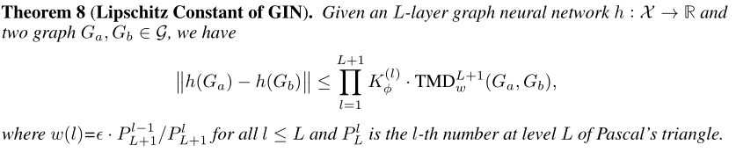
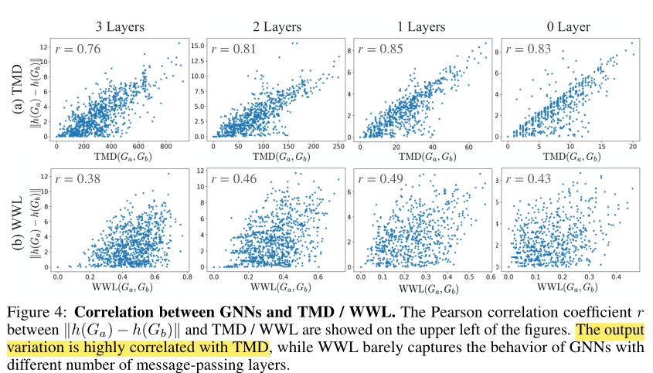
TMD and Stability of Graph Neural Networks
Next, we relate TMD to the perturbation stability of message passing GNNs. The resulting Lipschitz allows to analyze the stability of GNNs under perturbations and generalization bounds under distribution shifts.

Slide 12
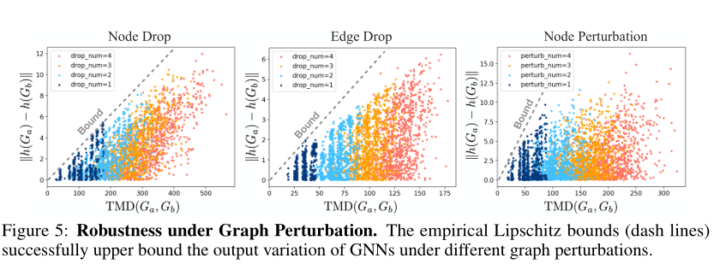
Stability of GNNs under Graph Perturbation
the output variation of GNNs under graph perturbation can be bounded via the TMD between the original graph and the perturbed one.
TMD strongly correlates with the output variation with large Pearson correlation coefficient, supporting the approach of defining the Lipschitz constant with respect to TMD, as in Theorem 8. In contrast, WWL barely captures the input graph perturbations that lead to output variation of GNNs.

Slide 13
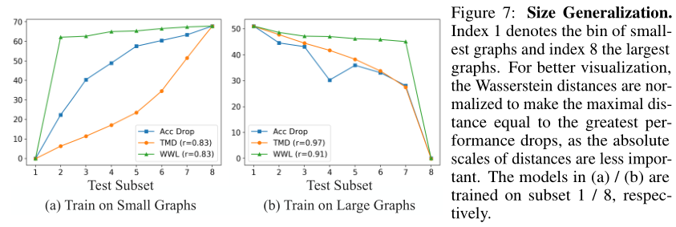
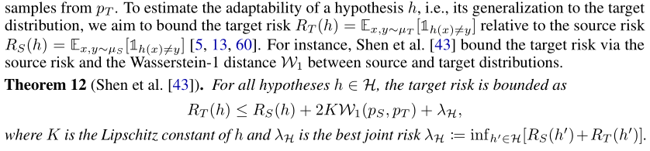
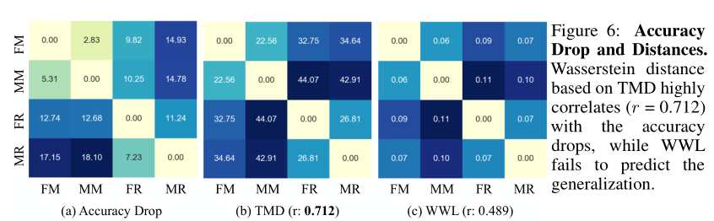
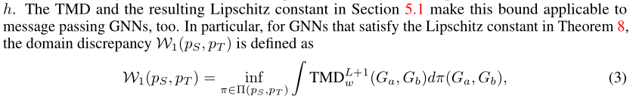
Generalization of GNNs under Distribution Shifts
Finally, we relate the Lipschitz condition of GNNs to the generalization error under distribution shifts by extending the results from [ 43 ].
To estimate the adaptability of a hypothesis h , i.e., its generalization to the target distribution, we aim to bound the target risk R T (h) = E x,y∼µ T [1 h(x)6=y ] relative to the source risk R S (h) = E x,y∼µ S [1 h(x)6=y ] [ 5 , 13 , 60 ]. For instance, Shen et al. [43] bound the target risk via the source risk and the Wasserstein-1 distance W 1 between source and target distributions.
As a baseline, we compute the Wasserstein distance with WWL transportation cost [ 46 ]. The W 1 distance based on TMD highly correlates with the accuracy drop (Pearson correlation r =0.712), while WWL-W 1 only achieves r =0.489.

